Slide 1
CS - 571
Database Systems for BS (DS)
Lecture 1-2: Introduction
Dr. Khurram Shahzad
khurram@pucit.edu.pk
Punjab University College of Information Technology

Slide 2
Agenda
Introduction
Course Material
Course Evaluation
Course Contents

Slide 3
Course Evaluation
Sessional (25)
Mid Term (35 marks)
Final Term (40 marks)

Slide 4
Rules of Business!
Please
  Ringing Phone
  Attendance Problem
  Sessional Problems
  Class Timing

Slide 5
Introduction to the course
Areas to be covered
Database design and application development
Concurrency and robustness
Efficiency and scalability
Tools for manipulating database

Slide 6

Have you ever designed a software?

Slide 7
Have you ever implemented a software?

Slide 8
Have you ever seen the backend of a software?

Slide 9
Database
Def 1: A shared collection of logically related data, designed to meet the information needs of multiple users in an organization
Def 2: A collection of data, part numbers, product codes, customer information
Def 3: A data structure that stores metadata
Def 4: An organized collection of information in a computarized format

Slide 10
Database Management System
DBMS on the other hand is the software or tool that is used to manage the database and its users
DBMS consists of different components or subsystem that we will study about later
DBMS is a collection of different programs but they all work jointly to manage the data stored in the database and its users

Slide 11
DBMS vs DBs
Database is a collection of data
DBMS is tool to manage this data
Jointly they are called database system

Slide 12
Data versus Information
Example:
A company has two divisions and the two division has 1,380,456 and 1,453,907 invoices, respectively.
Each invoice has invoice number, date, and amount
The period is from the first quarter of 1997 to first quarter of 2002
Total 2,834,363 records

Slide 13
Data versus Information
… | … | …
3000124 | 12-Jan-2002 | $121.98
… | … | …
Data
Information:----------?

Slide 14
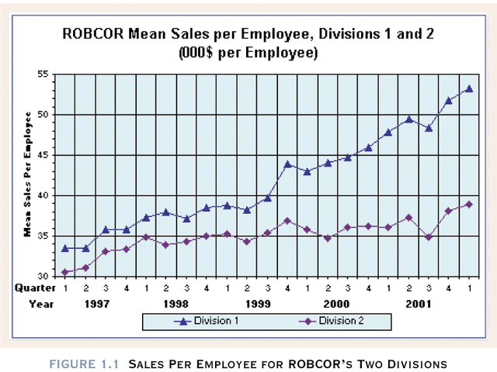

Slide 15
File System Critique
File System Data Management
  Requires extensive programming
  Time consuming
  Makes ad hoc queries impossible
  Data Redundancy (Unnecessary Duplication of data)

Slide 16
Database
Database is shared, integrated computer structure that stores a collection of data:
  End user data (raw data)
  Metadata (data about data, it contains data characteristics and relationships)

Slide 17
Database Management System (DBMS)
Non-technical
is just a computerized record-keeping system.
Collection of data in the form of files, electronic filing cabinet
A software or application providing operations on the data like, adding new files, inserting new data, retrieving existing data, updating and deleting data,removing files etc.
DBMS is an application, which holds user data permanently and then provide different operations on this data e.g., retrieval of data, insertion of data, updation of data etc.

Slide 18
Database Management
Database Management System (DBMS): software system (collect of software) help to manage the data contents
  Manages database structure
  Controls access to data
  Contains query language
Application software
DBMS
Database

Slide 19
Importance of DBMS
  Makes data management more efficient and effective
  Query language allows quick answers to ad hoc queries
  Provides better access to more and better-managed data
  Reduces the probability of inconsistent data
  Improved data sharing
  Improved data security

Slide 20
Jobs of DBA
Defining schema
Liaising with users
Defining security and integrity rules
Defining backup and recovery procedures
Monitoring performance and responding to changing requirements

Slide 21
The Relational Database (Model)
It is a prescription for a way of representing data by means of tables (relations) and a prescription for a way of manipulating data using some operators.

Slide 22
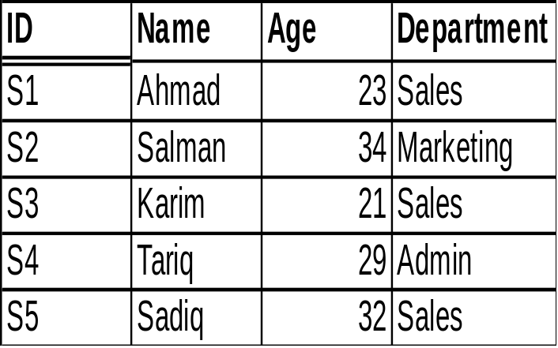
Terms in Relational Model
Relation
Tuple, Attribute
Cardinality
Domain
Employee Relation
attributes
tuples
Cardinality

Slide 23
Properties of Relations
There are no duplicate Tuples
All attributes have atomic values
Tuples are unordered
Attributes are unordered

Slide 24
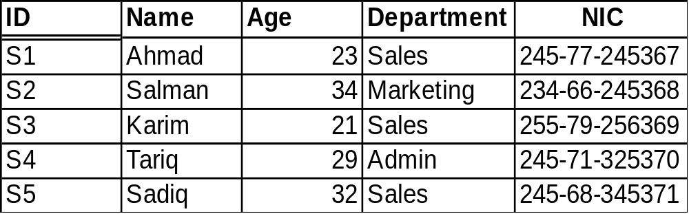
Terms in Relational Model
Candidate key
  General definition:
    A set of attributes which can uniquely identify each row in the table
  Relational Model Definition:
    Let R be a relation. Then candidate key for R is a subset of the set of attributes of R say K, such that:
    Uniqueness Property:
    no two distinct tuples of R have the same value for K.
    Irreducibility property:
    no proper subset of K has the uniqueness property

Slide 25
Terms in Relational Model
  Possible Candidate Keys?

Slide 26
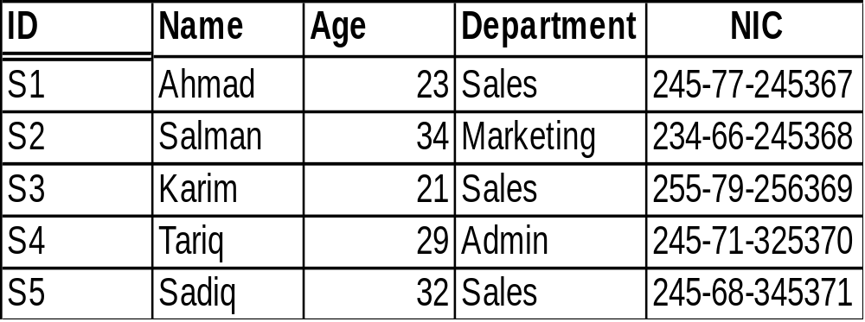
Terms in Relational Model
Primary key
  is a unique identifier for the table, that is , a column or column combination with the property that, at any given time, no two rows of the table contain same value in that column or column combination.
  One of the candidate keys
Alternate Keys
  All candidate keys other than primary key are called alternate keys

Slide 27
Terms in Relational Model
Primary Key: ID
Alternate Key: NIC

Slide 28
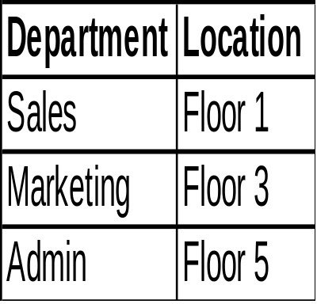
Terms in Relational Model
Foreign key
  General definition:
    A set of attributes in a table whose values are taken from the values of candidate key of some other table
Same values

Slide 29
Terms in Relational Model
  Relational Model Definition:
    Let R2 be a relation. Then a foreign key in R2 is a subset is a subset of the set of attributes of R2, say FK, such that:
    there exists a base relation R1 (R1 and R2 not necessarily distinct) with a candidate key CK and
    for all time, each value of FK in the current value of R2 is identical to the value of CK in some tuple in the current value of R1
Same values

Slide 30
Terms in Relational Model
Referenced tuple or Target tuple
Referencing relation
Referenced relation or Target relation
Simple key vs Composite key
Referencing relation
Target relation
Target tuple

Slide 31
Terms in Relational Model
Foreign key rules
  Restricted
  Cascade
  possible cases: update, delete
Referential integrity
  database must not contain any unmatched foreign key values
Nulls
  candidate keys shouldn’t have null values

Slide 32
TASK
Consider the relations given below. Provide following information for each of them:
name of relation, heading of relation, cardinality, degree, domain of each attribute.
What would be the maximum number of elements in the domain of an attribute in a relation if its cardinality is 13.
S# P# Qty
S1 P1 300
S1 P2 200
S1 P3 400
S1 P4 200
S1 P5 100
S1 P6 100
S2 P1 300
S2 P2 400
S3 P2 200
S4 P2 200
S4 P4 300
S4 P5 400
Supplies
Parts
P# P.Name Color Weight City
P1 Nut Red 12 Lahore
P2 Bolt Green 17 Karachi
P3 Screw Blue 17 Multan
P4 Screw Red 14 Lahore
P5 Cam Blue 12 Karachi
P6 Cog Red 19 Lahore

